Slide 1

Year 5 parent presentation
‘Flourishing together, with God as our firm foundation’.

Slide 2

Year 5 Staff
​
​
Class 5T​
​
Ms Tregunna
​
​
LSA- Mrs Wanless-Kyme
Class 5GB
Mrs Goddard (Monday and Tuesday)
Mrs Baylie (Wednesday-Friday)
LSA- Miss Plume
Mrs Redwin and Mr Neumann will cover PPA time

Slide 3

Our School Values
Every child is expected to demonstrate and understand our school values.
They are displayed in every classroom and around the school, and underpin everything we do.

Slide 4
Golden Promises
Our schools have 3 simple Golden Promises that everyone will follow.
I promise to ‘Be safe’
I promise to ‘Be ready’
I promise to ‘Be kind and respectful’

Slide 5

Golden Promises
This poster is displayed in every classroom.

Slide 6
Golden Promises
Be safe
Be ready
Be kind and respectful
You will keep your hands and feet to yourself.​
You will always be somewhere that is supervised by an adult.​
You will use school equipment properly and safely.​
You will only go on the parts of the premises in which you are allowed.​
You will walk sensibly around the school.
You will enter the classroom quietly.
You will have all your learning tools ready.​
You’ll be sat at a tidy desk. ​
You will be listening and following instructions.​
You will have everything you need, have eaten properly, slept well and been to the toilet.​
You will wait your turn to speak.​
You will listen to the person that is speaking, giving them eye contact.​
You will say nothing if you cannot say anything kind.​
You will not touch things that are not yours.​
You will be polite and show good manners.
Just some of the ways in which we can uphold our Golden Promises.

Slide 7

BEHAVIOUR
Rewards and Sanctions
Headteacher’s Awards and Hall of Fame
Class Rewards – Marble Jar
Dojo Points
  Friday Mufti when reaching 100 Dojo points – slip home
  House rewards for the most points each half term
Support available – laddered response to behaviour
Respect slips
Restorative conversations/Reflect and reset
More serious consequences when necessary

Slide 8

ZONES OF REGULATION

Slide 9

ZONES OF REGULATION

Slide 10
Reminders
Smart uniform everyday. Smart school PE kits on PE days (currently Monday and Friday) – any changes will be communicated via Class Dojo).
Children are not to bring mobile phones or any other electronic communication devices (eg smart watch) to school.
Long hair should be tied back using blue, black, white or brown hair accessories. Large bows/flowers and other decorative hair accessories are not allowed.
Jewellery should be kept to a minimum. Any earrings should be small plain studs and must be removed or taped for PE.
Children can bring a small pencil case with the following items if they wish: blue handwriting pen, writing pencil, colouring pencils, pencil sharpener, eraser, ruler, whiteboard pen, glue stick, purple pen for editing. Please refrain from buying your child anything that could distract them from their learning, such as novelty rubbers and scented pens/pencils.
Children should bring a water bottle to school every day.

Slide 11
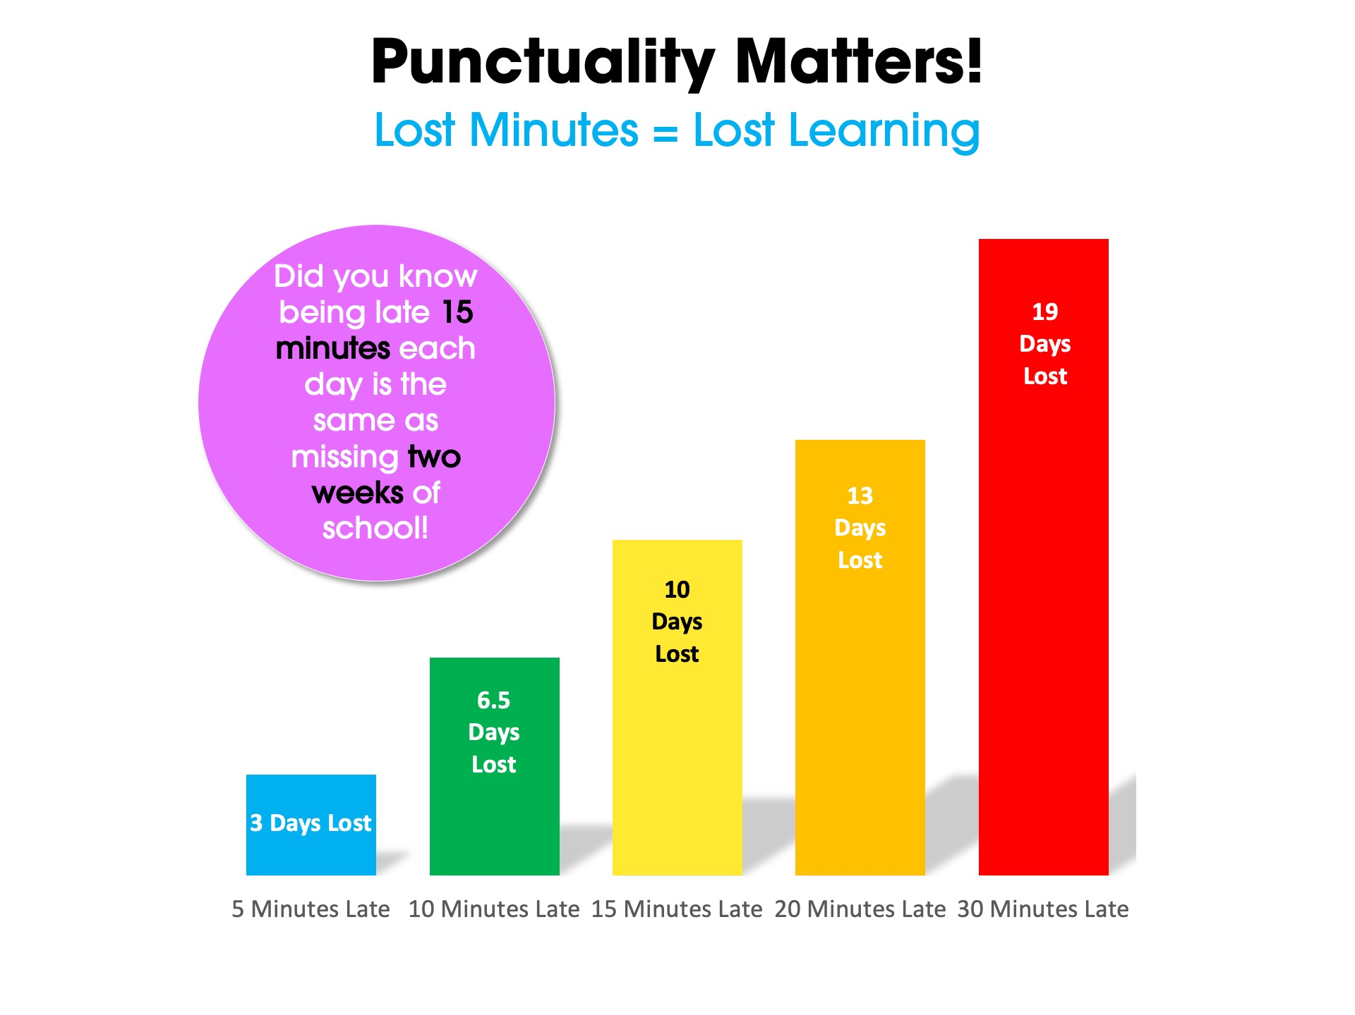
The School Day
Morning routine:
Soft start
Early morning work (spelling/ timestables etc)
Interventions/1-1 reading
Registration/ dinners
Assembly – brings us all together
Gates open | 8:35
Registration | 8:50
Collective Worship | 9:00
Session 1 | 9:15
Break | 10:15
Session 2 | 10:30
Lunch | 12:15
Session 3 | 1:10
Hometime | 3:20
Notes:
Highlight the importance of being in on time to complete morning activities (interventions and reading with adults etc) and how assembly brings us all together – children who aren’t in during this time feel disconnected from school and their peers.

Slide 12
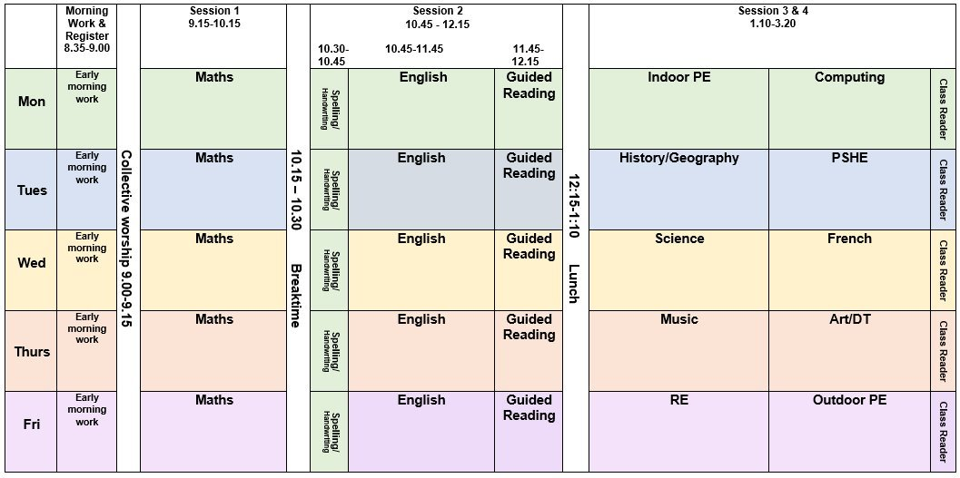
TIMETABLE

Slide 13
CURRICULUM
Curriculum overviews available on school website
Autumn Term Overview
Science | Forces Space | R.E. | Christianity - Creation Hinduism
History (Aut 1) | Were the Vikings raiders, traders or something else? | Geography (Aut 2) | What is life like in the Alps?
PSHE | Being me in my world Celebrating difference | Computing | Computing systems & networks Creating media – video production
Art (Aut 1) | Craft and design - architecture | DT (Aut 2) | Food tech – adapting a recipe
Music | Guitar with Mr Harrison (starting on the 17th September) | French | My family, Pets, Dates
PE | Aut 1 – Football/Gymnastics/Swimming Aut 2 – Hockey/Yoga | PE days will initially be Monday (indoor) and Friday(outdoor).

Slide 14
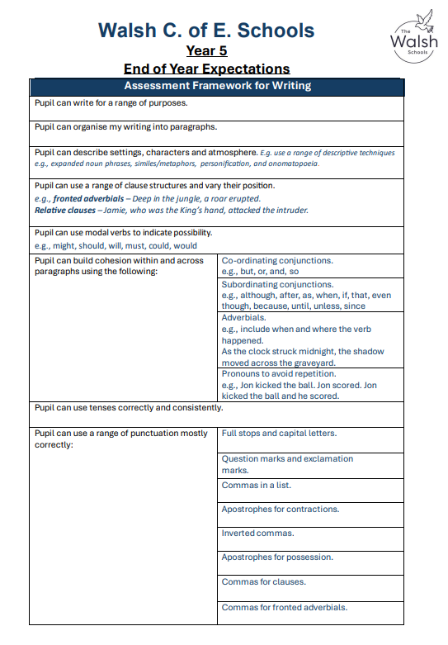


EXPECTATIONS
SEE HANDOUT -
One of our key school priorities this year is developing children's spelling, punctuation and handwriting skills. These are essential building blocks for confident and successful writing across all areas of learning.
You can help support your child at home by:
Encouraging daily reading and discussing new words together.
Practising weekly spelling words for a few minutes each day.
Supporting neat handwriting by encouraging correct letter formation and pencil grip.
Looking out for punctuation when reading books and talking about why it is used.
Giving your child opportunities to write at home, such as shopping lists, cards, diaries or notes.
.

Slide 15
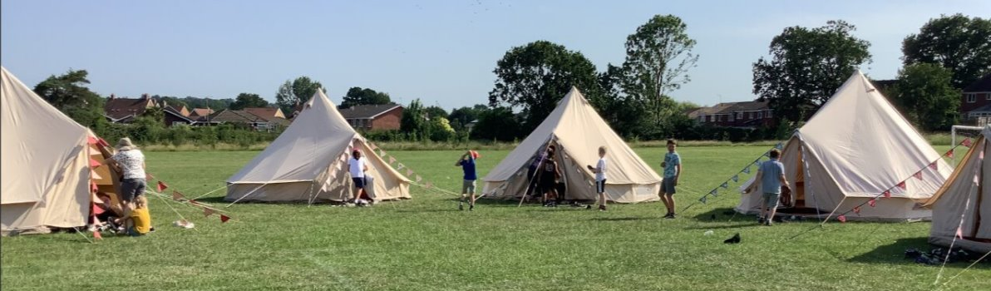

KEY DATES
Keep an eye on the school newsletter!
School Camp – Monday 21st September
Swimming –
every day during week beginning 28th September​
Viking Day – 14th October​
Wonder Dome Planetarium – 26th November​
Parents Evening – November TBC
TBC – Spring term – Hampton Court; Summer term – Portsmouth Aquarium

Slide 16

CLUBS

Slide 17





HOMEWORK
Children have been givien their logins.
Frequent reading - Children should be reading at least 5 times a week.
We will no longer be using reading diaries this year but Miss Clark will send communication out shortly explaining our new online reading system - watch this space!
Spellings set on a Monday and tested on a Friday.
Maths homework set/checked every Tuesday.
Regular timestable practice – at least 3 times a week.

Slide 18

READING
School library – weekly visit
Class book corner
Class reader
Reading scheme/ free readers
Reading for pleasure
Reading to adults
Reading lessons –
  Fluency
  Comprehension
Notes:
Reading comes in SO many different forms so build it into everyday life – recipes, signs, song lyrics. Reading for pleasure – children copy what they see and not what they’re told so we need to role model reading. Build it as a ritual into your routine.

Slide 19

WE NEED YOUR HELP
Ensure timely and regular attendance at school
Correct smart school uniform – labelled
Support to implement the school’s behaviour policy
Sign up to Class Dojo
Interact with us – we are here to help!
Reading
Maths/timestables
Spelling
Feedback
Parent Helpers – reading, trips etc

Slide 20
Attendance
Regular school attendance is essential as every school day is important. Every day lost can have a serious impact on your child’s attainment and overall progress in school. We expect children to attend school unless they are too unwell to do so. All absence must be reported to the school office by 9:30am to ensure the correct register code.
Please consult term dates before planning family holidays.
A request for an absence to be authorised will only be granted in exceptional circumstances, and holidays are not generally considered to be an exceptional reason.
Medical appointments, where possible, should be organised out of school hours. Where this is not possible, please book them after 1:30pm.
We work closely with the Local Authority to monitor attendance. An Inclusion Officer (IO) visits the school each term to monitor attendance, particularly where it is below 90%. We will also contact them when there are patterns regarding declining attendance or lateness, which may be subject to penalty notices.

Slide 21
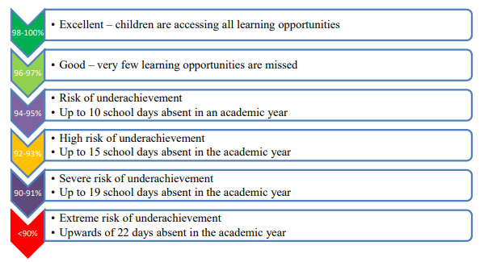
Attendance
Attendance for 1 year | Days lost | This equates to…
95% attendance | 9 Days | nearly 2 weeks
90% attendance | 19 days | nearly 4 weeks
85% attendance | 29 days | nearly 6 weeks
80% attendance | 38 days | nearly 8 weeks
75% attendance | 48 days | nearly 10 weeks
70% attendance | 57 days | nearly 11.5 weeks
65% attendance | 67 days | nearly 13.5 weeks
Minutes Late | Learning days lost per year
5 minutes | 3 days
10 minutes | 6.5 days
15 minutes | 10 days
20 minutes | 13 days
30 minutes | 19 days
Children are required to attend school for 190 days each year. There are 175 days for holidays and other activities. We expect attendance rates to be 95% and above.
Attendance Incentives

Slide 22


Support for families
ELSA MHST CAFÉ WALSH
WORKSHOPS REFERRALS/COURSES ASPIRATIONS WEEK
RESPONSIVE/PROACTIVE WESBITE
Class Teachers, SENDco, SLT
Any topics you are interested in – Let us know!
Notes:
We want to be a community hub and the more we can gather people in our hub – Café W – the more support we are able to gain. Any topics you are interested in, please let us know.
ELSA books – can loan to families!

Slide 23

COMMUNICATION
We are proud of our open communication at The Walsh Schools. You can contact us in many ways:
Quick messages at drop off/pick up (please make an appointment if you need a longer chat)
Email via the school office
Non-urgent quick messages via Class Dojo (may not always be picked up straightaway)
Other support available via the school office:
  Mrs Johnson (ELSA and pastoral support)
  Mrs Devonshire (SENDCO)
  Mr Bailey (Headteacher)
  Miss Huntbach (Assistant Headteacher)
  Mrs Wall (Deputy Headteacher)

