Slide 1

Year 6 parent presentation
‘Flourishing together, with God as our firm foundation’.

Slide 2
CURRICULUM
Autumn Term Overview
Science | Living things and their habitats Electricity | R.E. | Christianity and Hinduism
History (Aut 1) | How does the census affect local areas? | Geography (Aut 2) | Why does population change?
PSHE | Being me in my world Celebrating difference | Computing | Basic computer skills
Art (Aut 1) | Drawing – making my voice heard. | DT (Aut 2) | Navigating the world.
Music | Film music | French | Phonics Animals

Slide 3
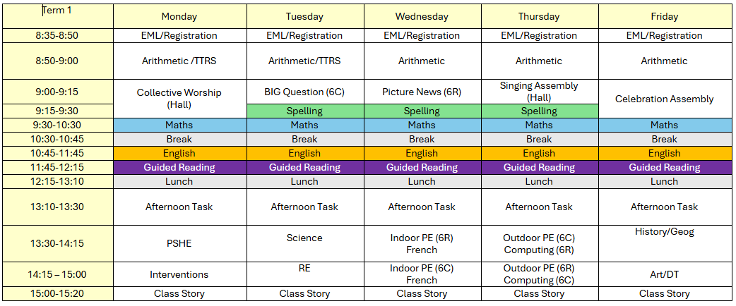
TIMETABLE
PE days:
Monday – Outdoor
Friday - Indoor

Slide 4
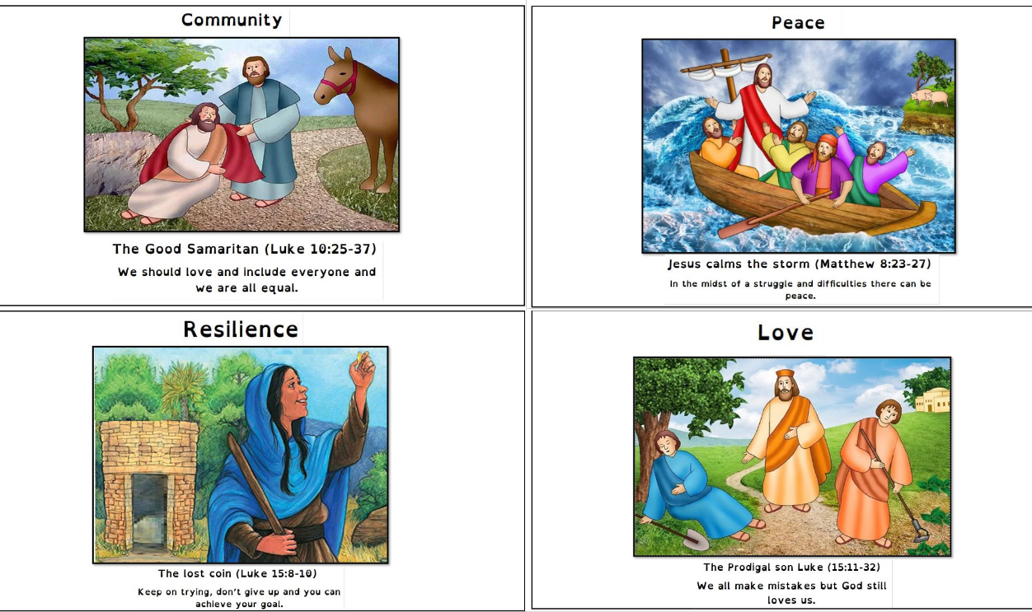
Our School Values
Every child is expected to demonstrate and understand our school values.
They are displayed in every classroom and around the school, and underpin everything we do.

Slide 5
Golden Promises
Our schools have 3 simple Golden Promises that everyone will follow.
I promise to ‘Be safe’
I promise to ‘Be ready’
I promise to ‘Be kind and respectful’

Slide 6
Golden Promises
Be safe
Be ready
Be kind and respectful
You will keep your hands and feet to yourself.​
You will always be somewhere that is supervised by an adult.​
You will use school equipment properly and safely.​
You will only go on the parts of the premises in which you are allowed.​
You will walk sensibly around the school.
You will enter the classroom quietly.
You will have all of your learning tools ready.​
You’ll be sat at a tidy desk. ​
You will be listening and following instructions.​
You will have everything you need, have eaten properly, slept well and been to the toilet.​
You will wait your turn to speak.​
You will listen to the person that is speaking, giving them eye contact.​
You will say nothing if you cannot say anything kind.​
You will not touch things that are not yours.​
You will be polite and show good manners.
Just some ways in which we can uphold our Golden Promises.

Slide 7
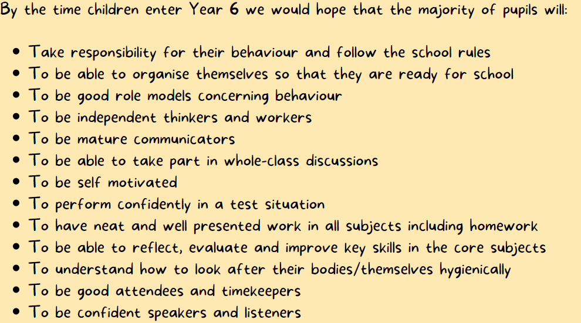

Slide 8

BEHAVIOUR
Rewards and Sanctions
Headteacher’s award – Gold Award and Star of the Week
Presentation Aware
Class rewards
Dojo Points:
  Individual rewards when reaching particular milestones
  House rewards for the most points each month
Support available
Respect slips
Restorative conversations
More serious consequences when necessary

Slide 9
KEY DATES
Swimming – every day during week beginning ​Monday 5th October 2026
Bikability – Week beginning 16th November and week beginning 23rd November
Keep an eye on the school newsletter!

Slide 10



HOMEWORK
Homework – Year 6 homework is a little different.
It is set Friday to Friday. We are using CGP books to support them for SATs and preparing for Secondary School
Spellings are set on a Wednesday to be tested the following Wednesday.
Reading frequently - Reading diary filled in 5 times a week (by child or adult) and signed by a parent at least one a week.
Regular timestable practice – every day.

Slide 11
COMMUNICATION
We are proud of our open communication at The Walsh Schools. You can contact us in many ways:
Quick messages at drop off/pick up (please make an appointment if you need a longer chat)
Email via the school office
Non-urgent quick messages via Class Dojo (may not always be picked up straightaway)
Other support available via the school office:
  Mrs Johnson (ELSA and pastoral support)
  Mrs Devonshire (SENDCO)
  Mr Bailey (Headteacher)
  Miss Huntbach (Assistant Headteacher)

Slide 12

Café W
Café W is continuing this year with Mrs Johnson running a tea and coffee drop-in session each Wednesday morning at 8:50-10am.
Tea and coffee will be free, all are welcome.

