Slide 1

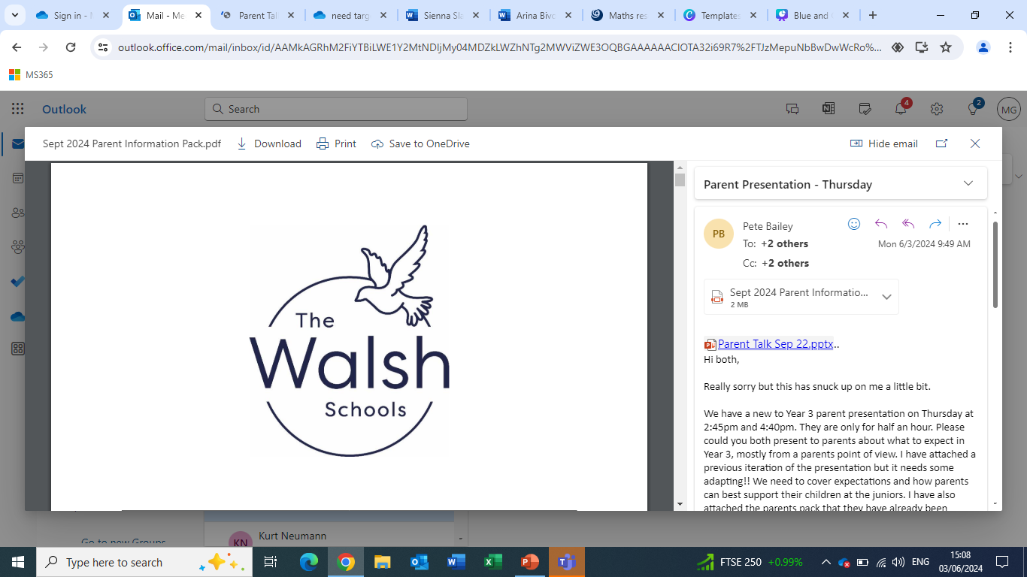

New to year 3
2026-2027

Slide 2
Introductions to the new team.
The Team
Natalie Vaughan– 3V
Angela Boyer–M/T 3BR
Sarah Richards – W/TH/F 3BR

Slide 3

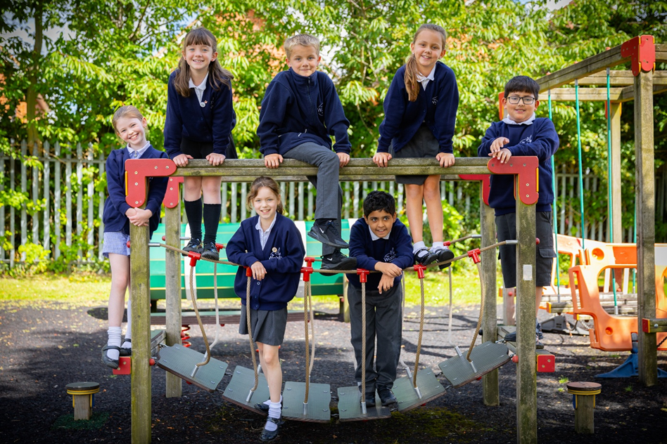
BACK TO SCHOOL 2026
Wednesday 2nd September 2026
Autumn Term 2026
Tuesday 1st September 2026 – INSET Day 1
Wednesday 2nd September 2026 – Term starts
Monday 19th October 2026 – Friday 30th October 2026 – Half Term
Friday 18th December 2026 – End of Autumn Term (Pick up time TBC)
NEWSLETTER – most up to date term dates

Slide 4
The school day.
Gates open 8.35
Registration 8.50
Collective Worship 9.00
Morning break 10.15 or 10.30
Lunchtime 12.15 – 1.10
School ends 3.20
The school day starts at 8.50am and we open the doors from 8.35am, to ensure a prompt start to the day.
SCL run a Breakfast Care Club from 7.30am and an After School Care Club which runs until 6.00pm.
The children enter the school building via their exterior classroom doors which open onto the playground.
The school day finishes at 3.20pm and teachers will dismiss the children from their classroom door.
Your child will have their own locker outside of the classroom for their bags and coat. They will also have access to a tray to put things in throughout the day.

Slide 5
Uniform – MUST BE named
School Uniform
PE kit
Earrings
• Walsh Schools/Plain navy Sweatshirt, Walsh Schools/Plain navy Cardigan or Walsh Schools/Plain navy Fleece
• White polo shirt with or without logo
• Tailored, grey or black trousers, shorts, skirt or pinafore dress
• Grey, black, navy or white socks or tights
• Black trainers or school shoes (sandals, ballet styled shoes, coloured soles/laces are not acceptable)
White t-shirt with school logo or a plain white t-shirt.
• Black or navy shorts.
Running trainers for outdoor use.
• Plain black or navy jogging bottoms and a plain black or navy sweatshirt may be worn for outdoor games in the winter.
PE Kit to school on PE days.

Slide 6

APPEARANCE
Hair
Make up
Nails
Jewellery
Watches

Slide 7
SCHOOL MEALS
Children in Year 3 are no longer entitled to Universal Free School Meals. All parents, unless you are entitled to Free School Meals will need to pay for lunches.
Please note that we are cashless and we require our parents to use the online payment system, Scopay. If you would like any help setting up your online account please speak to the school office.
Our school meals are provided by Caterlink. The cost of a school meal is £2.85 per meal per day, or £14.25 per week, which must be paid in advance.
The menu is available to view on our website. Children may choose to have school meals on some days and a packed lunch on others.
At morning registration, the children can select their dinner from a choice of three meal options. This can also be pre-ordered at home via Scopay, if you prefer.
You can discuss with your child beforehand whether they would like the ‘red’, ‘green’ or ‘yellow’ meal option. Your child does not have to be a vegetarian to have the green option. Please note meals may be subject to change.

Slide 8
Feedback
Medication
School Office
Doors
COMMUNICATION
Scopay—This is the system we use to make payments for trips, clubs and school meals etc. Please note that we are cashless and all payments will need to be made online via Scopay. If you require a barcode to make cash payments at a pay point counter, please contact the School Office.
School Website – www.walshschools.uk
Copies of letters, our school calendar and other school information is updated to our website regularly.
Newsletters – The Headteacher writes a newsletter every week which is sent to parents on Friday. All important dates are included on this.
Facebook—We invite you to ‘follow’ and ‘like’ our Facebook page that can be found at:
www.facebook.com/walshjuniorschool
Email – We use Arbor for our correspondence and will communicate all events and information with you via email – please ensure we have your correct email address.
Class Dojo – Your child’s class teacher may send short messages about activities taking place in class
via Class Dojo – you will receive login details when your child starts.

Slide 9
ATTENDANCE
Regular school attendance is essential as every school day is important. Every day lost can have a serious impact on your child’s attainment and overall progress in school. We expect children to attend school unless they are too unwell to do so. All absence must be reported to the school office by 9:30am to ensure the correct register code.
Please consult term dates before planning family holidays.
A request for an absence to be authorised will only be granted in exceptional circumstances, and holidays are not generally considered to be an exceptional reason.
Medical appointments, where possible, should be organised out of school hours. Where this is not possible, parents will need to complete the Absence Request Form, available from the school office, stating the reason for absence, the time of leaving and expected return.
We work closely with the Local Authority to monitor attendance. An Inclusion Officer (IO) visits the school each term to monitor attendance, particularly where it is below 90%. We will also contact them when there are patterns regarding declining attendance or lateness, which may be subject to penalty notices.

Slide 10
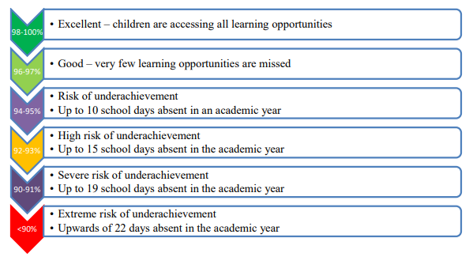
ATTENDANCE
Attendance for 1 year | Days lost | This equates to…
95% attendance | 9 Days | nearly 2 weeks
90% attendance | 19 days | nearly 4 weeks
85% attendance | 29 days | nearly 6 weeks
80% attendance | 38 days | nearly 8 weeks
75% attendance | 48 days | nearly 10 weeks
70% attendance | 57 days | nearly 11.5 weeks
65% attendance | 67 days | nearly 13.5 weeks
Minutes Late | Learning days lost per year
5 minutes | 3 days
10 minutes | 6.5 days
15 minutes | 10 days
20 minutes | 13 days
30 minutes | 19 days
Children are required to attend school for 190 days each year. There are 175 days for holidays and other activities. We expect attendance rates to be 95% and above.

Slide 11



School values

Slide 12
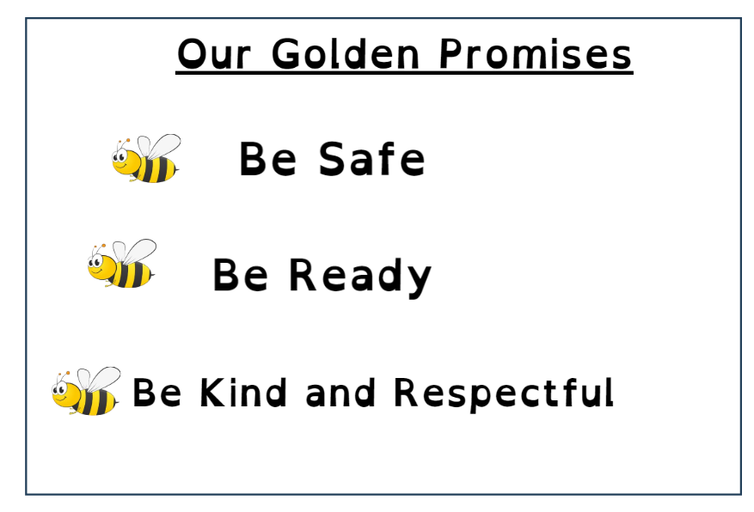
Our golden Promises

Slide 13
BEHAvIOUR
Sanctions
• To create a culture of exceptionally good behaviour; for learning, for community, for life.
• To respect and care for all members of the school community, adults and children as reflected in our Christian ethos.
• To help learners take control over their behaviour and be responsible for the consequences of it.
• To build a community which values kindness, care, cooperation, and empathy for others.
• To develop courage and resilience in overcoming difficult situations, being able to move on from them positively.
• To encourage pupils to make ‘good choices’.
• To promote community cohesion through improved relationships.

Slide 14
SUPPORT FOR FAMiLIES
ELSA MHST CAFÉ WALSH
WORKSHOPS REFERRALS/COURSES ASPIRATIONS WEEK
SWIMMING RESPONSIVE/PROACTIVE
WESBITE
Class Teachers
SENDco
SLT

Slide 15

Curriculum Enrichment
Aspiration/
Creativity Week

Slide 16

Curriculum Enrichment

Slide 17
Curriculum Enrichment
Some extracurricular events that occur throughout the year include:
Special weeks/days- world book day, Art week, Mental health awareness week, Charity events, Father's/Mother's day, Panto visit to school, Pause Days.
Sports Events- District sports, Netball matches/tournaments, Football tournaments/festivals, Physifun festival, Sports day, Tennis lessons at Ash Manor tennis club.
Trips/Educational Experiences- Butser Farm, Science Museum, History boxes from Farnham museum.
Extra Curriculur Clubs- Minecraft club, Maths club, Football club, Chess club, Drama, Music Lessons (Guitar & Keyboard), Art club, Netball club, Athletics, Morning circuits, Forest school , Gymnastics club.
Weekly Celebration Assembly that celebrates children's achievements.

Slide 18









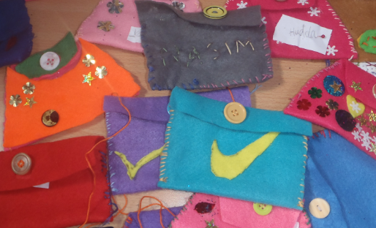




Curriculum Experiences
History/Geography
English
Maths
Science
Art & D.T.
RE
Christianity through art
PE
French
Computing
Music
PSHE
Summer 2 RSE
Important times for Jewish people

Slide 19

equipment
LABEL EVERYTHING
Smiggle/Key Chains
Writing pencils
A small set of colouring pencils
A pencil sharpener
An eraser
A ruler with centimetres/millimetres
A whiteboard pen
A glue stick
A purple biro
Stationery on our list should be brought to school in a simple, small, plain or clear pencil case
Don't forget to bring a named water bottle!

Slide 20
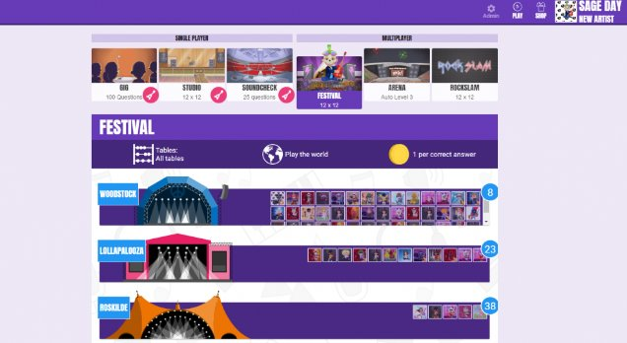
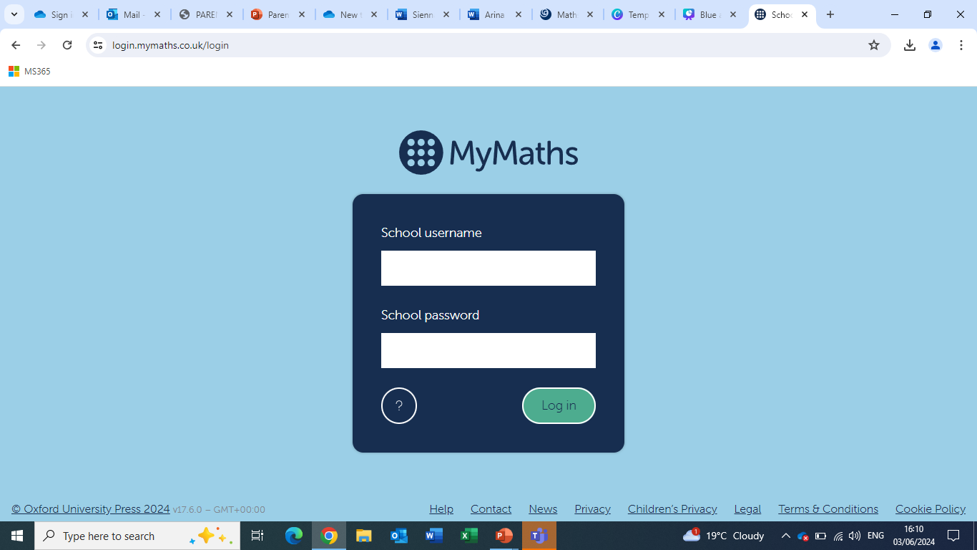
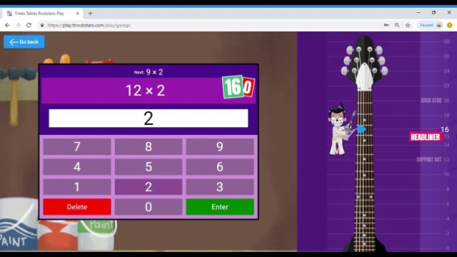
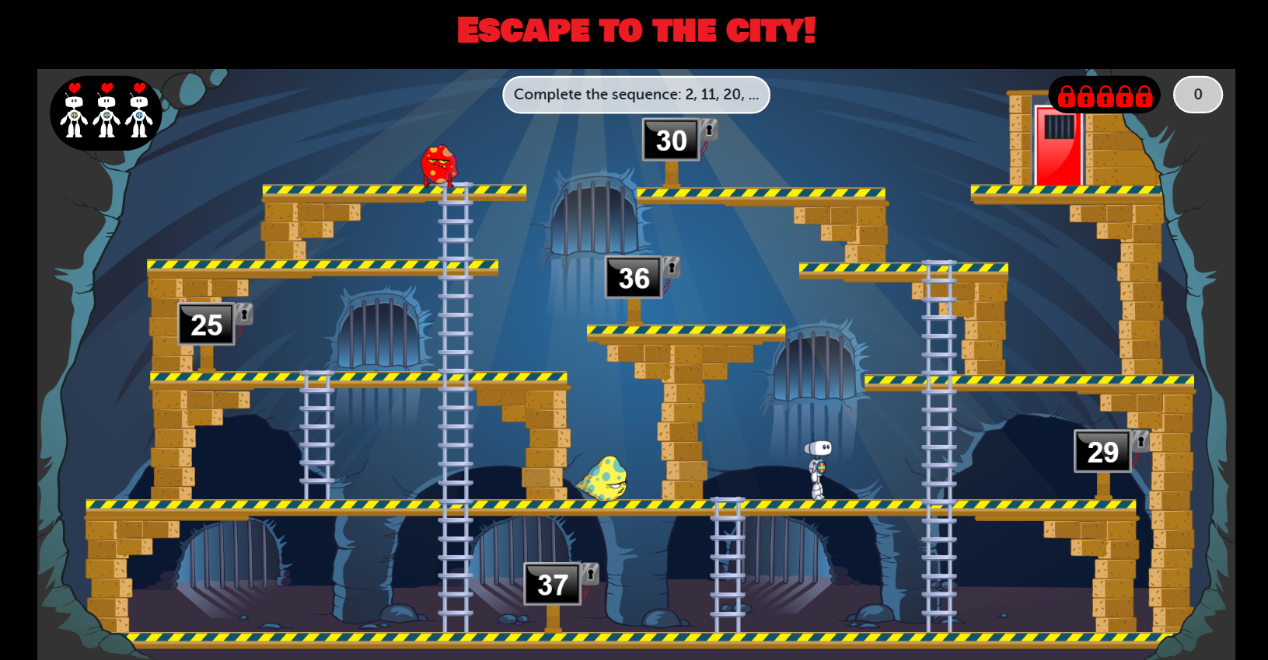
Homework
Homework at The Walsh Schools consists of supporting children with basic skills:
Regular reading
Learning of number facts
Essential spellings
TTRS
My Maths
This allows children to practice key skills that they learn and develop at school. It supports a positive learning attitude – an area essential for your child’s progress!

Slide 21

Reading
Library
Class books
Reading Scheme
Reading for Pleasure
Reading to adults
Fluency
Comprehension
Reading is a vital skill which enables children to fully access the school curriculum.
Children are expected to read a minimum of 3 times per week and it MUST be recorded in their reading diary.
Reading diaries must be in school daily and are monitored by staff on Tuesdays.

Slide 22
Times Tables
By the end of Year 2, national expectation is that a child knows and can apply their 2-, 5- and 10-times table.
By the end of Year 3, children are expected to know and apply their 3-, 4-, 8- and 6-times table.
By the end of Year 4 children are expected to be able to recall all times tables up to 12 x 12 with a response time of less that 6 seconds.
Every child in Year 4 will sit a government times table test called the MTC in June of Year 4.

Slide 23
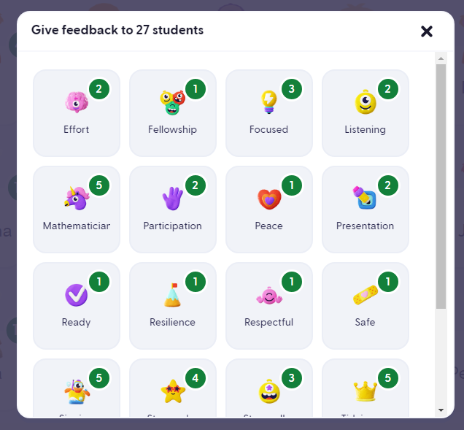
Class Dojo
We use Class Dojo at The Walsh Schools. This is a reward system that award points for good behaviour. Our values and golden promises are on there too!
You will be given a QR code to access your child's account, when their monster hatches they can personalise it to make it their own. When they reach 100 dojo points they will
receive a ticket which can be traded for a mufti-day (only on Fridays).
You will receive instructions on how to connect to the account as a parent.
This is completely FREE and allows you to track your child’s behaviour, message class teachers and see your child’s shared learning.

Slide 24
Transition Day
On the morning of Wednesday 1st July 2026, your child will come into school to attend their transition day. If your child attends Walsh Infant School, they will be escorted over by members of staff. If your child attends another school, they will need to be dropped off to Walsh Junior School by yourselves at 9:15am. They will need to arrive through the school office.
They will meet their new class teacher, LSA and new class for the first time. On this morning, they will take part in lots of engaging activities to help them to settle into their new school and build connections to their new school community.

Slide 25
Questions

